Slide 1



Distributed Dynamic Diversity Databases for Life
1st Periodic Review 24 June 2010 Brussels
Work Package 4
Foresight study for geographical extension:
the Global Multi-Hub Network
Jiří Kvaček, Národní muzeum
Frank Bisby, University of Reading

Slide 2



Objectives
i) To bring together for the first time leaders of the various international centres to create Regional Hubs in the Sp2000 Multi-Hub Network
ii) Foresight Study to report the Needs, Conceptualisation, Specification and subsequently the Design both for individual Regional Hubs, and for the Multi-Hub network as a whole.
iii) To carry out a limited amount of prototyping and testing
iv) Foresight Study to point the way for other potential regional hub centres, not yet part of the Multi-Hub Network, to form Regional Hubs and join the Network in future.

Slide 3
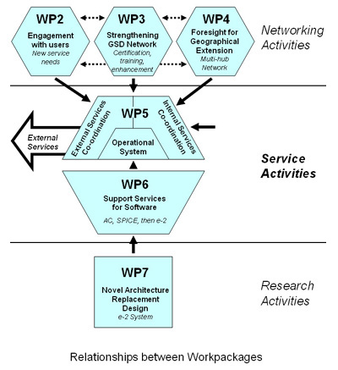
Relationships between Workpackages

Slide 4
Outcomes
During the first year of the project we organised two workshops in Reading and Faro.
Workshop in Reading on 15 September 2009
During the first workshop we discussed with representatives of the Regional Hubs their hopes and aspirations for the Multi-Hub Network.
To amplify this discussion with comparable responses, it was agreed to circulate a questionnaire and survey to the members of WP4.
A Wiki site and a mailing list were established for WP4.

Slide 5
Outcomes
Workshop in Faro (Portugal) on 16 February 2010
We tackled problems associated with specific items:
General pattern of the multi – hub network, data supply and format, wrappers, options and architectures,
Analysing project partner requirements,
Multi-hub service - questions and problems
Internal overlapping
Definition of geographical boundaries
Extra-boundary species
Unified style checklist for regions
Meaning and depth of synonym searches
In cooperation with WP 7 - Discussion about requirements for e-2 architecture
Building an ideal regional centre

Slide 6
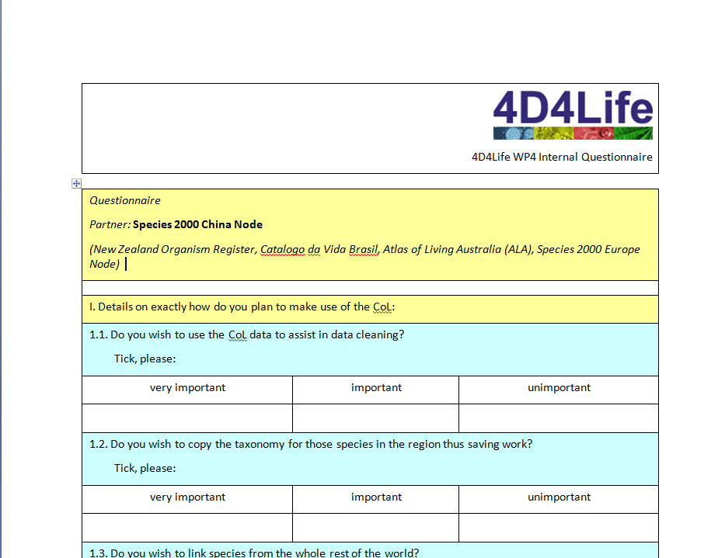
Questionaire

Slide 7
Analysing project partner requirements
Most important services required:
data cleaning,
aggregating common names
statistical information.
Other important issues:
Multilingual interfaces
Integration of regional databases
Frequency of update cycles; partner requirements in this regard range from one week to one year.
Foundation of regional centers, new GSDs and mirroring were generally accepted.
Data sharing usually is not a problem for most of the partners.

Slide 8
Parts of Task 4.1 relating to objective ii)
Objective ii):
How to relate and link between components in each regional taxonomy hub in the Global Multi-Hub Network and the ‘central’ Catalogue of Life hub.
Each taxonomy is maintained and continuously changing, in each hub – eg China, Australia, Brazil etc.
How to permit toggling by users between entries for the ‘same’ or ‘overlapping’ taxa in each regional taxonomy.
How to permit continental scale boolian arithmetic between whole biotas.
For example which species in Africa are not in S. America? Etc etc

Slide 9
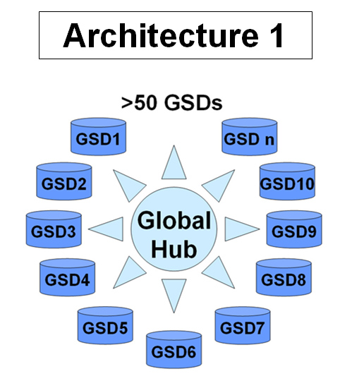

Slide 10
Inspecting and harvesting species from several hubs
ITIS
N. America
Europe
Global
Checklist
Brasil
China
Regional Checklist Hubs

Slide 11
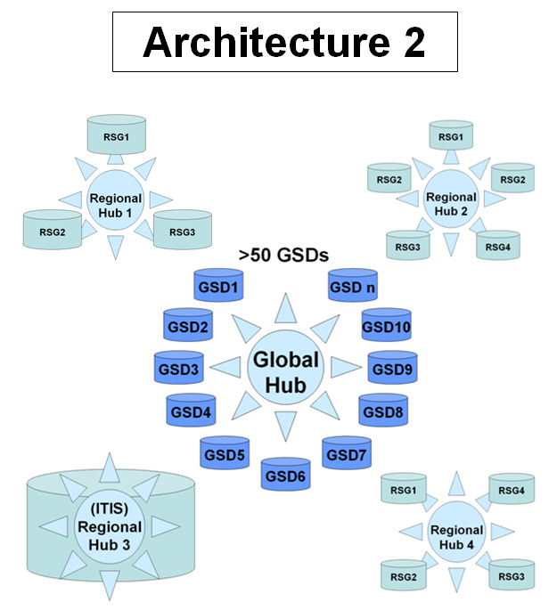

Slide 12
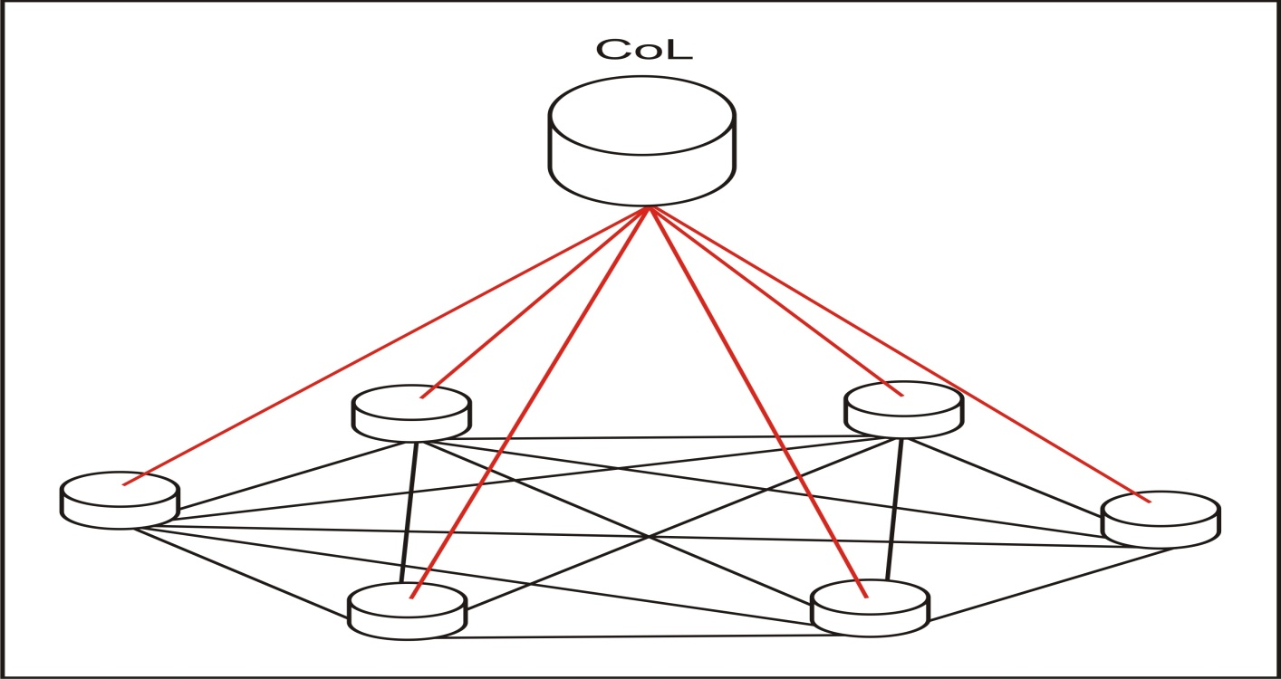
Central Objective
i) How to relate and link between components in each regional taxonomy hub
(maintained and continuously changing, in China, Australia, Brazil etc)
and the ‘central’ Catalogue of Life hub.
ii) to permit toggling between entries for the ‘same’ or ‘overlapping’ taxa in each
iii) to permit continental boolian arithmetic
(which species in Africa not in S. America? Etc etc)

Slide 13
Solution 1
map the red lines (radial x-maps from Col to each Regional Taxonomy)
re-map those red lines needed every time one changes

Slide 14
Solution 2
map all lines (x-maps from each to each taxonomy)
re-map those needed every time one component changes

Slide 15
Solution 3
Solution 3a (The ‘GNA’ solution):
first: store all taxonomies in one place, each as a map over the names
second: be able to read off x-map between any pair in real time
Solution 3b: AND replicate the store at each regional centre

Slide 16
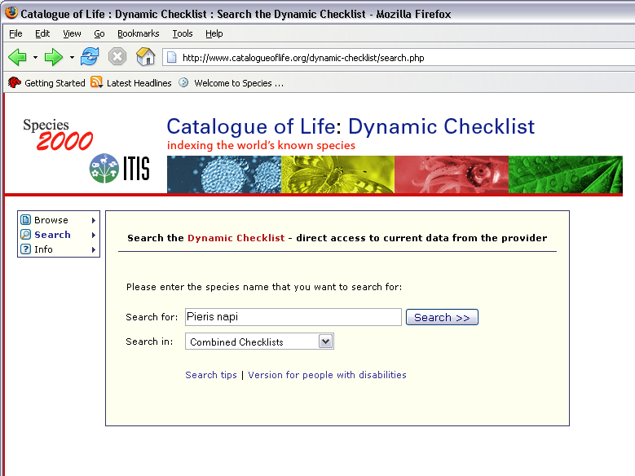

Slide 17
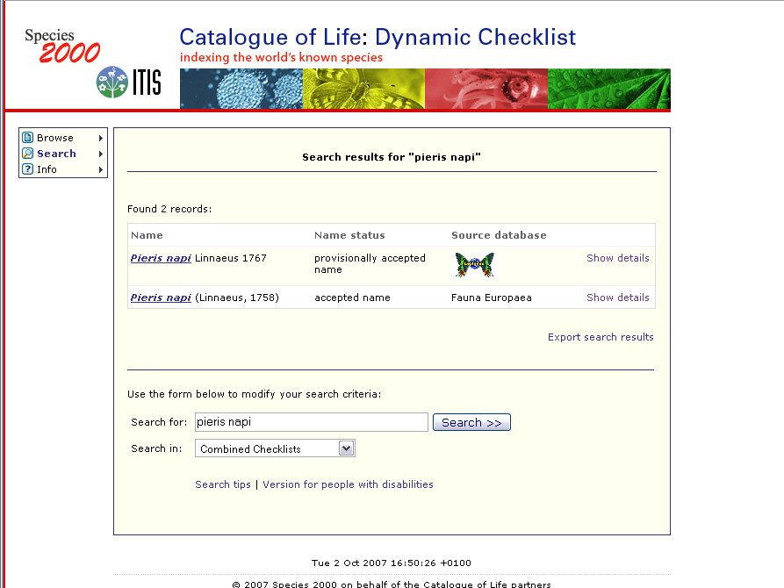

Slide 18
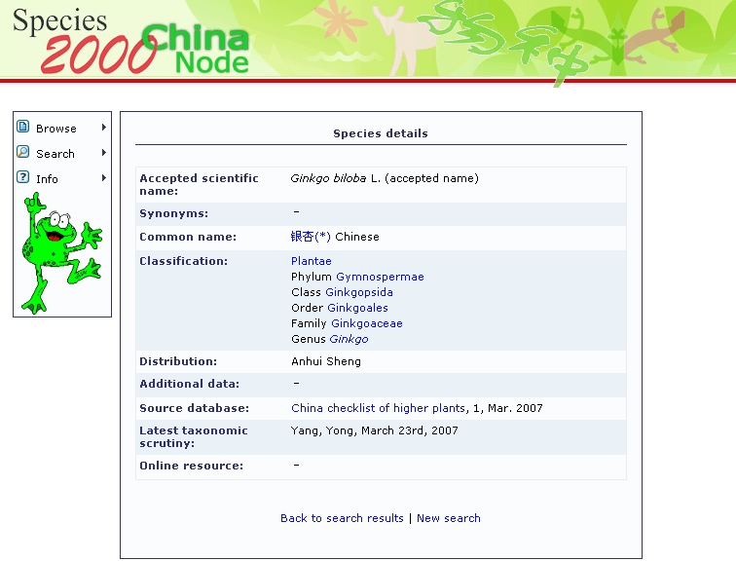

Slide 19
Ideal regional hub
Data collecting & networking
Organizing regional meetings
Editing regional newsletters
Setting up, recruiting and servicing GSDs
Mirroring of CoL
Preparation of CoL language interface
Data dissemination & publicity
PR campaigns in mass media
Website in national language(s)
AC & DC interfaces in national language(s)
CD production and distribution on site
Inquiry service [National Taxonomic Service]
Legislation of services with local government
Education
Publications (checklists and papers)
Presentations and lectures
Scholarships
Fund raising

Slide 20
Next steps
Multi-Hub Concept
Preparation of preliminary Specification and the Pilot Projects leading to a firm Concept
of the Multi-Hub Network by the Remedial Task Group.
Preparation of an outline plan for the extension of the Multi-Hub Network to cover the whole world including new centres, some from less advantaged parts of the world.
1st Pilot Project
Based on Concept of Multi-Hub network
Discussed already with Chinese colleagues
Workshop in Beijing is planned in October 2010
prototyping and testing based on the limited Multi-Hub Linkage tools available with the present SPICE system within Sp2000.
Possibioity for installing and testing Multi-Hub linkages using tools from the new e-2 Architecture of WP 7

